Slide 1
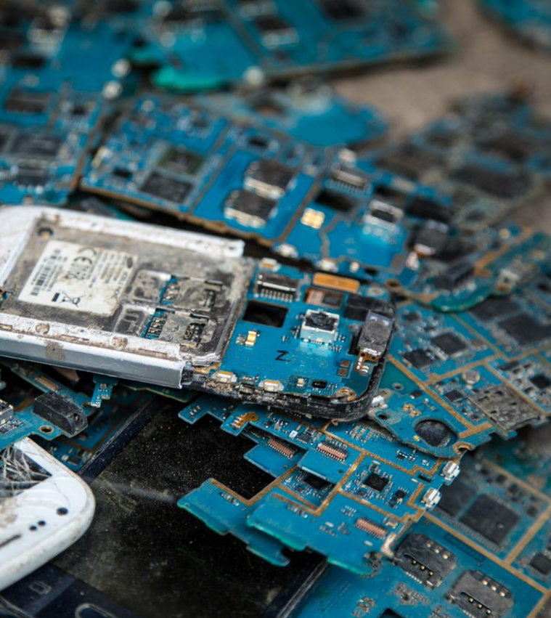
Outcome of the E-waste Data Harmonization Project - Pilot Study in Kenya and Burundi
EACO 5th REGIONAL E-WASTE WORKSHOP ON SUSTAINABLE E-WASTE MANAGEMENT IN THE EAST AFRICAN REGION, 22nd March 2023

Slide 2
Project background and objectives
Background
Provide technical assistance to harmonize e-waste data collection.
Burundi, Kenya, Rwanda, South Sudan, Tanzania and Uganda.
Support the relevant strategic actions of the EACO Regional E-waste Management Strategy.
Sustain a regional e-waste database maintained by the EACO Secretariat.
Ensure continuation of previous e-waste data and statistics support provided by the Global E-waste Statistics Partnership in the region.
Project partners:
Notes:
Hello everyone. I‘m Rosie McDonald from ITU‘s Environment and Emergency Telecommunications Division of BDT focussing on e-waste data. I would like to povide a brief reminder to this joint project by the ITU-the SCYCLE Team at UNITAR- and the East African Communications Organisation, which focuses on regional e-waste data harmonization through the development and trailing of household and business surveys.
The project aims to provide technical assistance to 6 members of the East African Communications Organisation to harmonize e-waste data collection.
EACO sought collaboration from ITU and SCYCLE to support various strategic actions of their Regional E-waste Management Strategy. One of the action points in the strategy is establishing a baseline and harmonized data bank on e-waste statistics for the region.
The project also complements previous e-waste data and statistics support provided by the Global E-waste Statistics Partnership in the region.

Slide 3
Project overview
Timeline
Supporting national statistics bodies to collect and improve e-waste data and statistics in a harmonized manner.
Validating country data through comparing and learning from pilot results during an in-person workshop.
Mar 2021
Inception Training
Validation Training
May 2023
01
02
03
04
05
Harmonized Surveys
Regional Trial
Publication
Developing regional baseline surveys for households and businesses.
Trialing the harmonized household and business surveys in Kenya and Burundi.
Publishing an East Africa E-waste Baseline Study focused on survey and E-waste Toolkit results.
Notes:
The project started in March 2021 and we are now preparing the final study for publication which is expected in late May/early June so today I‘ll be giving you a preview of the key results from our upcoming publication.
The project worked with NSOs to develop a standard baseline survey for households and businesses which has since been piloted in Kenya and Burundi using based in Kenya called GeoPoll.
In addition to the survey, we provided training on the E-waste Tool kit which is required to collect and improve e-waste data and statistics at the national level, in a harmonized manner, to ensure regional harmonization. The results of this are also in our report.
The East Africa E-waste Baseline Study will include both the data from the pilot surveys and the E-waste Toolkit. The publication will describe the methodologies, summarize the key statistics, stakeholders and surveys, and providing future recommendations.

Slide 4
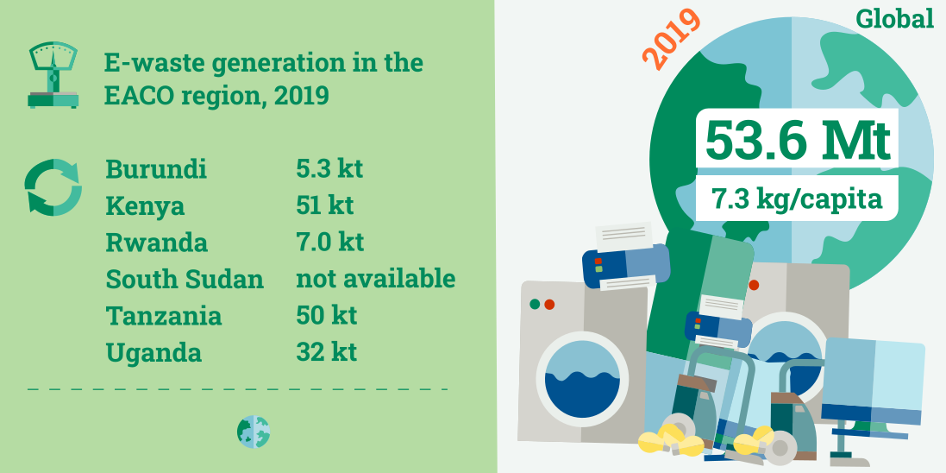
Importance of e-waste data
E-waste data
Serves as a basis for e-waste statistics, indicators and contributes to the SDGs.
Helps evaluate developments over time, set and assess targets, identify best practices for policy.
Improves comparability between countries.
Two approaches of collecting e-waste data; household and business data complements supply data and provides additional insights.
Estimates from ‘The Global E-waste Monitor 2020’
Notes:
So why is it important to collect data on e-waste?
Data helps to improve comparability between countries, it is highly desirable to have a sound measurement framework that can integrate existing harmonised data and can serve as the basis for e-waste statistics and e-waste indicators. Measuring e-waste is an important step towards addressing the e-waste challenge since statistics help to evaluate developments over time, set and assess targets, and identify best practices for policies.
The data shown here for the project countries are from the 2020 Global E-waste Monitor and based on estimates from supply and EEE put on the market data using a methodology developed by UNU to calculate e-waste generated. We hope you had a chance to look at the Tools again but please try and do so again before tomorrow as that’s what we’ll be focusing on.
In addition, household and business data can complement the supply data and provide additional insights such as household size, income levels, the product life-time and how the product has been disposed of and is an important step towards addressing the e-waste challenge since statistics help to evaluate developments over time, set and assess targets, and identify best practices for policies.
Piloting household and business surveys in Kenya and Burundi will help us to understand e-waste generation and disposal in specific areas. Questions focused on discard behavior, reasons to dispose and possession of Electronic and Electrical Equipment (EEE).
Based on a subset of the UNU-KEYS where products are classified by similar function, comparable material composition and end-of-life attributes.
The surveying was completed last week so we will have lots of opportunity to further explore the data.

Slide 5
Survey design
Survey background
Fridges [including. combi-fridges]
Freezers
Air Conditioners [household installed and portable]
Laptops [including. tablets]
Flat Display Panel Monitors for computers [LCD/LED]
Flat Display Panel Televisions [LCD/LED/Plasma]
Kitchen equipment [e.g. large furnaces/ovens/cooking equipment – electrical]
Washing Machines [including. combined dryers]
Dryers [wash dryers/centrifuges]
Microwaves [including. combined excluding. grills]
Equipment for food preparation [e.g. toaster/grills/food processing/frying pans] excluding hot water preparation
Small household equipment for hot water preparation [e.g. coffee/tea/water cookers]
Vacuum Cleaners [excluding. professional]
Personal Care equipment [e.g. tooth brushes/hair dryers/razors - electrical]
Desktop PCs [excluding. monitors/accessories]
Printers [e.g. scanners/multi functionals/faxes]
Mobile Phones [including. smartphones/pagers]
Telecommunication equipment e.g. [cordless phones/answering machines]
Survey aimed to understand e-waste generation and disposal.
Questions focused on discard behaviour, reasons to dispose, and possession of Electronic and Electrical Equipment (EEE).
The list of electronics used in the surveys are based on a subset of the UNU-KEYS where products are classified by similar function, comparable material composition and end-of-life attributes.
Notes:
The pilot surveys were conducted in Kenya and Burundi with the aim to obtain information on the possession rates of EEE in households and businesses in both countries as well as on the discarding behavior for e-waste, reasons to dispose and to identify the main disposal routes.
The list of electronics used in the surveys are based on a subset of the UNU-KEYS where products are classified by similar function, comparable material composition and end-of-life attributes. EEE includes a wide range of products with circuity or electrical components with a power or battery supply, EEE becomes e-waste once it has been discarded by its owner as waste without the intent of reuse. EEE comprises of a large variety of products as shown here.
The questions and the product scope were carefully designed in order to obtain the necessary information to draw the profiles of both countries.
The harmonized list of Electric and Electronic Equipment classifies the EEE in 54 products, also called UNU keys, the surveys were conducted only on a subset of the full list to reduce the complexity as well as to avoid posing questions on items that are unlikely to be owned either by the households or the businesses in question.
Thus, a total of 18 UNU keys were selected for the surveys, which is shown on the slide.

Slide 6
Pilot survey questions
Survey background
Which of the following electric/electronic products exist in your household/ business?
Which of the following electric/electronic products in your possession are functioning?
Of the following, how many of these electric/electronic products in your possession are functioning? (Quantity)
Which of the following electric/electronic products in your possession are not functioning?
Of the following, how many of these electric/electronic products in your possession are not functioning? (Quantity)
Which of the following products have you discarded in the past 24 months?
For each of the following products kindly tell me how many you have discarded in the past 24 months?
If you have discarded that product in the past 24 months, what was the disposal route for the #ProductsDiscarded?
Demographics:
Households: Age, Gender, Occupation, Income, Household size
Businesses: Using electronics, sizes based on number of employees: Micro (0-9 employees), Medium (10-49 employees), Large (50+ employees), All business sectors
Notes:
These are the key questions and demographics which the survey focused on.

Slide 7
Survey design
Survey background
Analysis | Quantitative
Method: | CATI & CAPI
Instrument: | Structured questionnaire
Source / Database: | GeoPoll Database
Sample Achieved: | Kenya Household CATI: N=507 Kenya Business CATI: N=308 Burundi Household CATI: N=351 Burundi Business CAPI: N=117
Sample Details: | Male/ female 18+ years
Location: | Kenya: Nairobi, Mombasa, Kisumu, Nakuru Burundi: Bujumbura, Muyinga, Gitega
Data Collection Dates 2022: | Kenya Household: 16th – 22nd Sept Kenya Business: 12th – 30th Sept Burundi Household: 14th – 26th Sept Burundi Business: 13th – 29th Sept
Language: | Kenya: English, Swahili Burundi: English, French, Kirundi
Notes:
This table provides a brief overview of the study scope, including the number of households and businesses surveyed, the locations of sampling, sampling dates in September 2022 and the languages which the survey was delivered in.
The survey was carried out using a mixed mode data collection approach. A quantitative structured questionnaire administered via a CATI (Computer Assisted Telephonic Interviews) platform was used to collect data for households in Kenya and Burundi and for businesses in Kenya. Burundi business survey were done using face to face interviews via CAPI (Computer assisted personal interview) platform.

Slide 8
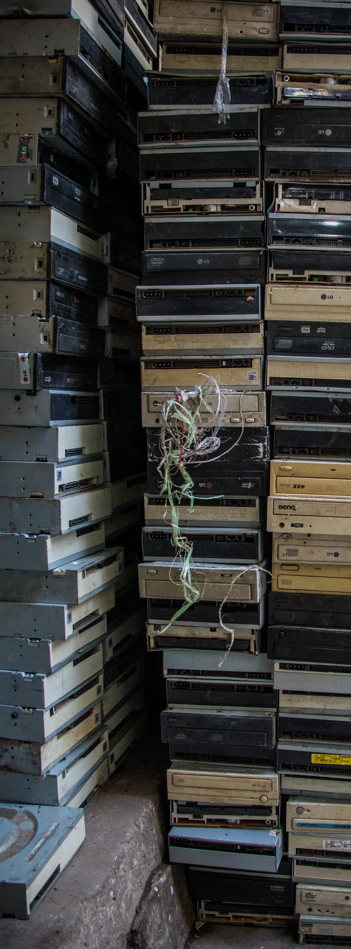
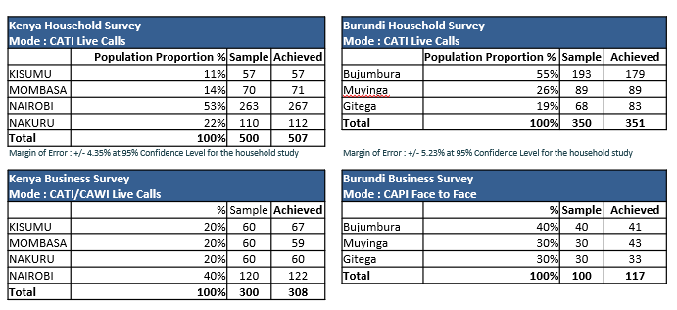
Survey design
Survey background
Methodology: Quantitative
Mode: Mixed mode (CATI and CAPI)
Household sampling:
For Household study, the sample was spread across the main/major towns. This was developed using a two-stage stratified cluster sampling.
Business sampling:
Kenya: list of businesses in the selected region was used as a frame and a random sample of telephone numbers and emails was drawn from a list of establishments using equal probability selection method.
Burundi: the study was administered through face-to-face interviews in the selected three regions. Simple random sampling method was used targeting business within the city in different location.
The target respondent for businesses were mainly the business owners or persons in business administrators.
Notes:
In terms of sampling:
For the Household study, the sample was spread across the main/major towns. This was developed using a two-stage stratified cluster sampling.
1st stage involved allocation of primary sampling units, regions, using the probability proportion to size (PPS) method.
2nd stage involved a random selection of mobile numbers from a GeoPoll panel. The mobile numbers from the panel were representative by Age and Gender within the specific regions.
Businesses:
Kenya Business, the distribution of the sample was by approximation and the aim was to achieve data that would be used to run further analysis per region.
A list of businesses in the selected region was used as a frame and a random sample of telephone numbers as well as emails was drawn from a list of establishments using equal probability selection method.
Burundi Businesses, the study was administered through face-to-face interviews in the selected three regions. Simple random sampling method was used targeting business within the city in different location. Within the specific locations mapping of business premisses was done & one business was selected for interview.
The target respondent for businesses were mainly the business owners or persons in business administrators.
Challenges:
With CATI Data collection:
No answer
Drop offs
Refusals
With CAPI Data Collection:
Refusals
Time taken to find a respondent took longer than CAPI
A variety of quality assurance and control mechanisms were implemented when conducting the surveys, including Video Checks, Automated and manual Data Quality Checks and call Back Checks from recordings

Slide 9
Kenya: Possession rates
Survey results
Notes:
The household survey conducted in Kenya revealed that the highest EEE possession rate applies to mobile phones, 98% of the Kenyan households interviewed possess at least one mobile phone. Possession rates are high also for Flat Display Panel Televisions (85%), Laptops (65%), Small household equipment (58%) and Fridges (51%). Other items are present in less than half of the households surveyed.
While in Kenyan businesses, similarly to households, Mobile Phones and Laptops are present in 93% and 65% respectively of the total surveyed, while Desktops are present in 53% of the businesses, printers in 53% and Small household equipment in 52%.
The majority of households posses only one of the items indicated in this list. 97% of the households interviewed in Kenya posses only one washing machine, 96% one microwave and 95% one fridge and freezer. For mobile phones, results show that a considerable amount of households (35%) own two mobile phones, 27% only one, 22% three, 10% four and 3% five.

Slide 10
Kenya: Non-working appliances
Survey results
Notes:
This chart shows the survey results for non-working appliances in Kenya households and businesses per product surveyed.
On average, 29% of the surveyed Kenyan households possed at least one non-functioning mobile phone, 10% one non-functioning Flat display panel, and one non-functioning Laptop.
For Kenyan businesses, the higher percentages of non functioning appliances applied to Mobile Phones (18%), Laptops (14%), Desktop PCs and Printers (both 13%) and Flat Display Monitors for computers (10%).
The discrepancy between households and businesses is high in the case of appliances that are most commonly used in the business sector such as Monitors, Desktop PCs and Printers.

Slide 11
Kenya: Products discarded in the past 24 months
Survey results
Notes:
The survey also addressed the amount of appliances that the consumer disposed of in the past 24 months, taking into account September 2022 as a reference (time when the survey was conducted).
The table here shows that Mobile Phones were the most commonly disposed of appliance by households in the 24 months preceding the survey. Consumers reported that 212 households and 106 businesses discarded at least one mobile phone.
Other commonly discarded products include flat display panel TVs, small household equipment, personal care equipment and laptops. Printers and desktops were also higher for businesses to disregard.

Slide 12
Kenya: Disposal routes
Survey results
Disposal route | Fridges | Laptops | Flat Display Panel TVs | Small Household Equipment | Mobile Phones
Picked up from home by the company that sold me the product | 30% | 7% | 11% |  | 5%
Collected by door-to-door worker | 10% | 5% | 4% | 10% | 7%
Sold online | 10% | 7% | 5% |  | 3%
Sold to a refurbisher or repair shop | 15% | 51% | 33% | 33% | 34%
Disposed of in the mixed municipal solid waste bin |  | 7% | 12% | 31% | 15%
County picked-up from home |  | 2% |  | 4% | 2%
Brought to an e-waste collection center or County designated drop off point | 20% |  | 2% | 2% | 4%
Picked up by an e-waste collection center |  | 2% | 2% | 2% | 1%
Donated | 5% | 9% | 18% | 2% | 11%
Other | 10% | 9% | 14% | 16% | 18%
Notes:
The surveys also investigated the most common disposal routes per appliance. This table shows the five appliances that are most common in Kenyan households: mobile phones, flat display panel televisions, laptops, small household appliances and fridges.
The differences in the disposal routes could possibly be linked to consumer behaviors as well as with intrinsic dynamics of the e-waste collection in the country.
Fridges, for example, are usually brought to an e-waste collection center or to a county designated drop off point (20% of the total) or they are picked up from home by the companies that sold the product to Kenyan households (30%), the latter disposal route is not used in the case of small household equipment as most is disposed together with mixed residual solid waste (31%) or it is sold to a refurbished or repair shop (33%).
On the other end, the majority of waste laptops are sold to refurbished or repair shops (51%), this is related to the fact that waste laptops have a positive value and therefore local refurbishers are making profit by refurbishing and selling them as a second hand products.
The same trend can be observed for flat display panel TVs - 33% is reported to be sold to refurbisher or repair shops, however, compared to laptops, a higher percentage is donated (18% of flat display panel TVs vs 9% of laptops).
Mobile phones are also often sold to refurbisher or repair shops (34%), this probably applies for relatively new smartphones, older smartphones or mobile phones are instead disposed of in the mixed municipal solid waste bin (15%) and 11% is donated.

Slide 13
Burundi: Possession rates
Survey results
Notes:
The household survey conducted in Burundi revealed that the highest possession rate applies to mobile phones, with 96% of households possessing at least one mobile phone. This trend is in line with the Kenyan survey. Possession rates are high also for Personal Care equipment (71%). All other items, including Flat Display Panel Television, Laptops, Small household equipment and Fridges are present in less than half of the households surveyed depicting a different situation than in Kenyan households.
In businesses, similarly to households, Mobile Phones and Personal Care equipment are present in 83% and 58% respectively of the total surveyed, while Printers are present in 26% of the businesses, Laptops in 27%, and desktops in 23%. Overall, possession rates are lower in Burundi for both households and businesses than in Kenya.
The majority of households possess only one of the items indicated in this chart. In fact, 100% of the households interviewed in Burundi possess only one laptop, 100% one Flat Display Panel television and 100% only one Fridge and Freezer. For Mobile Phones instead, results show that 48% of the households possess one Mobile Phone only, a considerable amount (26%) own two Mobile Phones, 15% three, 4% four and 3% five.

Slide 14
Burundi: Non-working appliances
Survey results
Notes:
This chart shows the survey results for non-working appliances in Burundi households and businesses per product surveyed.
On average, 18% of the surveyed Burundi households possess at least one non-functioning mobile phone, 29% one non-functioning Personal Care equipment, and 11% non-functioning Kitchen equipment.
In the case of businesses in Burundi, the higher percentages of non functioning appliances apply to Mobile Phones (12%) and Personal Care equipment (39%).

Slide 15
Burundi: Products discarded in the past 24 months
Survey results
Notes:
This chart shows the amount of appliances that the consumer disposed of in Burundi in the past 24 months prior to the time of the survey which occurred in September.
Personal Care equipment was discarded by the most households (201) and business (42). This is followed by Mobile phones at 116 for households and 18 by businesses. Kitchen equipment, equipment for food preparation also had higher discard rates in households compared to the other products surveyed.

Slide 16
Burundi: Disposal routes
Survey results
Disposal route | Mobile phones | Personal Care equipment | Flat Display Panel TVs | Kitchen equipment | Equipment for food preparation
Picked up from home by the company that sold me the product | 2% | 1% |  | 4%
Collected by door-to-door worker | 17% | 10% | 20% | 11%
Sold online | 3%
Sold to a refurbisher or repair shop | 21% | 0% | 20% | 2% | 19%
Disposed of in the mixed municipal solid waste bin | 13% | 49% | 20% | 51% | 30%
Brought to an e-waste collection center or County designated drop off point | 7% | 19% |  | 14% | 4%
Picked up by an e-waste collection center |  | 4% |  | 2%
Donated | 10% |  |  | 1% | 7%
Other | 27% | 15% | 40% | 14% | 41%
Notes:
The surveys also investigated the most common disposal routes per appliance. This table shows the five appliances that are most common in households in Burundi: Mobile Phones, Personal Care Equipment, Flat Display TVs, Kitchen equipment, Equipment for food preparation.
Mobile Phones for example, are usually sold to a refurbisher or repair shop (21%) or collected informally at home (17%), this is related to the fact that used or waste Mobile Phones have a positive value and therefore local refurbishers or informal collectors are making profit by refurbishing and selling them as second hand products.
Personal Care equipment, Kitchen equipment and Equipment for food preparation are mostly disposed of in the mixed residual solid waste (49%, 51% and 30% respectively).
Compared to the Kenyan results, less equipment in Burundi is picked up from home by the company that sold the products, in addition there is no evidence about equipment being collected by the County, less shares seems to be sold online or donated and higher number of households reported not to be informed about the disposal route or to be still in possession of the product (included in “Other”). This suggests there’s that there’s opportunity to raise awareness and market gaps for e-waste collection and recycling in Burundi, especially compared to Kenya.

Slide 17
E-waste generated: Kenya
E-waste Toolkit
Notes:
During the project, the countries were trained to use an e-waste toolkit which consist of a EEE POM Tool, that is used to collect and analyze EEE put on the market, and the E-waste Generated Tool which uses the POM data of EEE to calculate the E-waste generated.
Both tools are an integral part of the methodologies used for the calculation of the weight of electrical and electronic equipment (EEE), Put on Market (POM), and E-waste generated. It is based on the same methodologies as developed by the task group of the E-waste statistics Partnership for Measuring ICT for Development (Forti et al., 2018) and is what the GESP trains countries on globally to harmonize e-waste statistics.
The Tools have been developed by the SCYCLE team (formerly part of the United Nations University -UNU and recently transitioned to the United Nations Institute for Training and Research – UNITAR). The methodology used is further described in the E-waste Statistics Guidelines but please reach out to us if you want to know more about this approach as we can share further information.
The tools enable countries countries to generate their own statistics on EEE Put on Market and E-waste Generated,. The “EEE Put on Market” can be calculated as Imports – Exports + Domestic Production. If, however, the country does not have Domestic Production of EEE, the user can neglect it and consider only the Imports and Exports. Imports and Exports data can be obtained at the National Bureau of Statistics or at any other Trade Authority in the country.
The chart here is a result of this approach. EEE trade data for Kenya was provided from 2010 to 2021. To be able to capture all e-waste, the time series has been extended back to 1980 using UNITAR internal estimations.
E-waste generated in Kenya shows a rapid increase as a result of the increase of sales in the past 15 years. The total e-waste generation in Kenya is estimated to be 51.3 kt in 2021. The largest shares are represented by Small Equipment (16.7 kt) and Temperature exchange equipment (12kt).

Slide 18
E-waste generated: Burundi
E-waste Toolkit
Notes:
It is important to notice that Burundian country data are available from 2010 onwards.
The estimated e-waste generated in Burundi calculated with country data in 2021 corresponds to 1.8 kt.
Compared to Kenya, Burundi has a much smaller population so less EEE is put on the market.
It is recommended that countries update regularly the EEE POM and E-waste Generated tool (once a year) to get the most reliable estimates of e-waste generation in the country that can be useful for developing policies and waste management guidelines and targets.

Slide 19
Lessons learned and conclusions
Lessons learned and conclusions
Important to use in-country field teams, especially for local languages. Team training and mock interviews were important for the pilots.
Inform the population e.g. radio, TV, newspaper so they are aware that a survey is going on.
Ensure robust data collection methods, storage and back-up plans to avoid loss of data.
Data from one question was lost but due to having recordings and call back numbers, the data was recoverable.
It was flagged that some survey participants in Burundi initially interpretated ‘personal care equipment’ as non-EEE products like combs and toothbrushes.
Visual aids of the different categories and continuously reinforcing that the focus of the survey is on EEE would help present this issue arising in the future.
Import to not double count EEE such as mobile phones in household and business surveys - add ‘is this for your home or business only use?’
Notes:
Important to use in-country field teams and local people when conducting surveys, especially when local languages are needed (e.g. in Burundi, the survey team switched to Kurundi instead of French). Team training and mock interviews were important for the pilots and should be continued if the project moves into a second phase.
It would have been beneficial for national statistical offices to inform the population (radio, TV, newspaper) so they are aware that the survey is going on – the project budget did not allow this would be important in any follow up projects.
Important to ensure robust data collection methods, storage and back-up plans to avoid loss of data – data from one question was lost but due to having recordings and call back numbers, most of the data was recoverable.
It was flagged that some survey participants in Burundi initially interpretated ‘personal care equipment’ as non-EEE products like combs and toothbrushes – visual aids of the different categories and continuously reinforcing that the focus of the survey is on EEE would help present this issue arising in the future.
Import to not double count EEE such as mobile phones in household and business surveys - it will be important to add to the question ‘is this for your home or business only use?’ The surveyors reassured that this will not be an issue for this survey since the household and business respondents were unique but is something you should be aware of when conducting national surveys.
It can be very difficult to draw the line between micro businesses and a single person – it is an issue of ownership, but it is still common for EEE such as mobiles, laptops to be also used for personal use.

Slide 20
Lessons learned and conclusions
Lessons learned and conclusions
Challenging to draw the line between micro businesses and a single person.
Criticism of CATI (telephone surveying) due to potential quality control issues.
During COVID some NSOs adopted CATI and then compared to CAPI results and found them to be robust.
Trade-off between cost and the numbers needed for robust statistics.
Need to acknowledge new technologies which makes other options other than in-person surveying an option.
Every approach has its strengths and weaknesses, a lot of quality control happens (multi-media recoding, listening to 10% of calls, filtering out data or excluding participants if they have doubts).
Suggested to include a follow-up question for non-functioning EEE, it won’t automatically become e-waste – ‘Do you plan to repair this item in the future?’
Conduct some focus group discussions, including via WhatsApp going forward to better explore some of the responses.
Notes:
Some of partners NSOs were critical of using CATI (telephone surveying) due to quality control issues and the potential of people to make up the numbers. However, some NSOs highlighted that during COVID, they had to adopt the CATI methodology and then compared to CAPI results and found them to be robust. Both CAPI and CATI were selected since this was a pilot, we were still facing potential challenges with COVID and there is a trade-off between cost and the numbers needed for robust statistics.
There is a need to acknowledge that new technologies are evolving which makes other options other than in-person surveying an option. In addition, NSOs highlighted that getting reliable data can also be problematic if you appear at someone’s house and they can rush through a survey and make mistakes to make you leave faster.
Basically every approach has its strengths and weaknesses but putting in place a lot of quality control during surveying helps (e.g. multi-media recoding, listening to 10% of calls, filtering out data or excluding participants if they have doubts).
It was also suggested to include a follow-up question for non-functioning EEE as it doesn’t always automatically become e-waste – a questions such as ‘Do you plan to repair this item in the future?’ will help.
It would be good to do some focus group discussions, including via WhatsApp going forward to better explore some of the responses and to dive deeper into the topic.

Slide 21
Contact: Dr. Rosie McDonald
E-waste Data Associate Officer
rosie.mcdonald@itu.int

